Slide 1
Analyzing and Mitigating the Impact of Permanent Faults on a Systolic Array Based Neural Network Accelerator
Ref: https://arxiv.org/pdf/1802.04657.pdf

Slide 2
Deep neural network accelerator
Due to the compute intensive nature of DNNs, several accelerator designs have been proposed in the literature to accelerate the inference process of DNNs.
These accelerators are mainly capable of performing efficient vector and matrix multiplication operations, which are the fundamental operations in the DNN inference.
This is achieved by using multiple computational units which operate in parallel and by enabling local data sharing/reuse in these units.

Slide 3
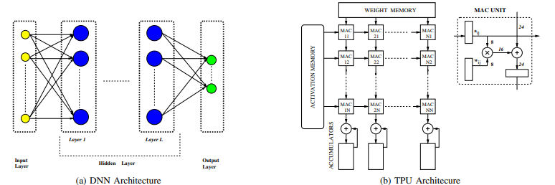

Slide 4
The Tensor Processing Unit (TPU)
prominent DNN accelerators developed by Google for addressing the increased cloud-based DNN related workloads.
TPU is a systolic array composed of processing elements (PEs) that are connected in a 2D grid like manner.

Slide 5
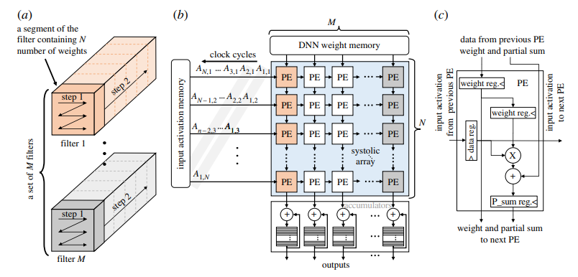
. (a)The steps show the sequence of unrolling and mapping of the weights onto the array. (b) baseline systolic array-based DNN accelerator (similar to the design of well-know systolic arrays like Google TPU and Eyeriss, illustrating the mapping of a segment of filters highlighted in (a). (c) Detailed design of the processing element (PE).

Slide 6
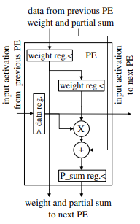
Processing element (PE)
The PEs work in lock steps with their neighbouring PEs to generate the output.
For example, in the first clock cycle, the top left corner PE will multiply the first weight with the first input activation and then pass the partial output to its downstream neighbour and the input activation to the PE on its right side.
The downstream PE (i.e. the second PE in the first column), in the next clock cycle, computes the product of the second weight with the second activation and adds the available partial product from the upstream PE to generate the partial product for its downstream PE.
In the meantime, the first PE in the first column will generate the first partial product related to the second input activation vector and the first PE in the second column will generate the first partial product related to the first input activation vector.
By continuing this procedure, the result of the first dot product from the systolic array will be available after N clock cycles and, at peak, the array can generate one result per clock cycle per column.

Slide 7
processing element (PE)
If the number of weights in the filters/neurons is more than the number of rows in the array, the weights cannot be mapped to the array at the same time.
In such cases, the results generated by the array are not complete, and the accumulation units connected below the array are responsible for storing the partial products and accumulating them with the rest of the corresponding partial products of the filters/neurons to compute the final outputs.

Slide 8
Scaling Problem
An important challenge with future technology scaling is the increase in fault rates, including both permanent (hard errors) and temporary faults (soft errors).
Temporary faults might occasionally impact the DNN’s classification results, but their overall impact on classification accuracy is small.
Permanent faults can affect the result of every DNN execution and significantly reduce the classification accuracy.
While permanent faults, at least those that are related to manufacturing defects, can be identified during post-fabrication testing, discarding every chip with a permanent fault reduces yield.

Slide 9

Yield
Although the goal of every fabrication process is to produce only working dies, in practice the process is never perfect and not all dies work or operate as desired within specs.
Yield is a quantitative measurement of the process quality in terms of working dies.
Where,
N_{good} - number of working dies per wafer
N_{total} - number of dies per wafer

Slide 10
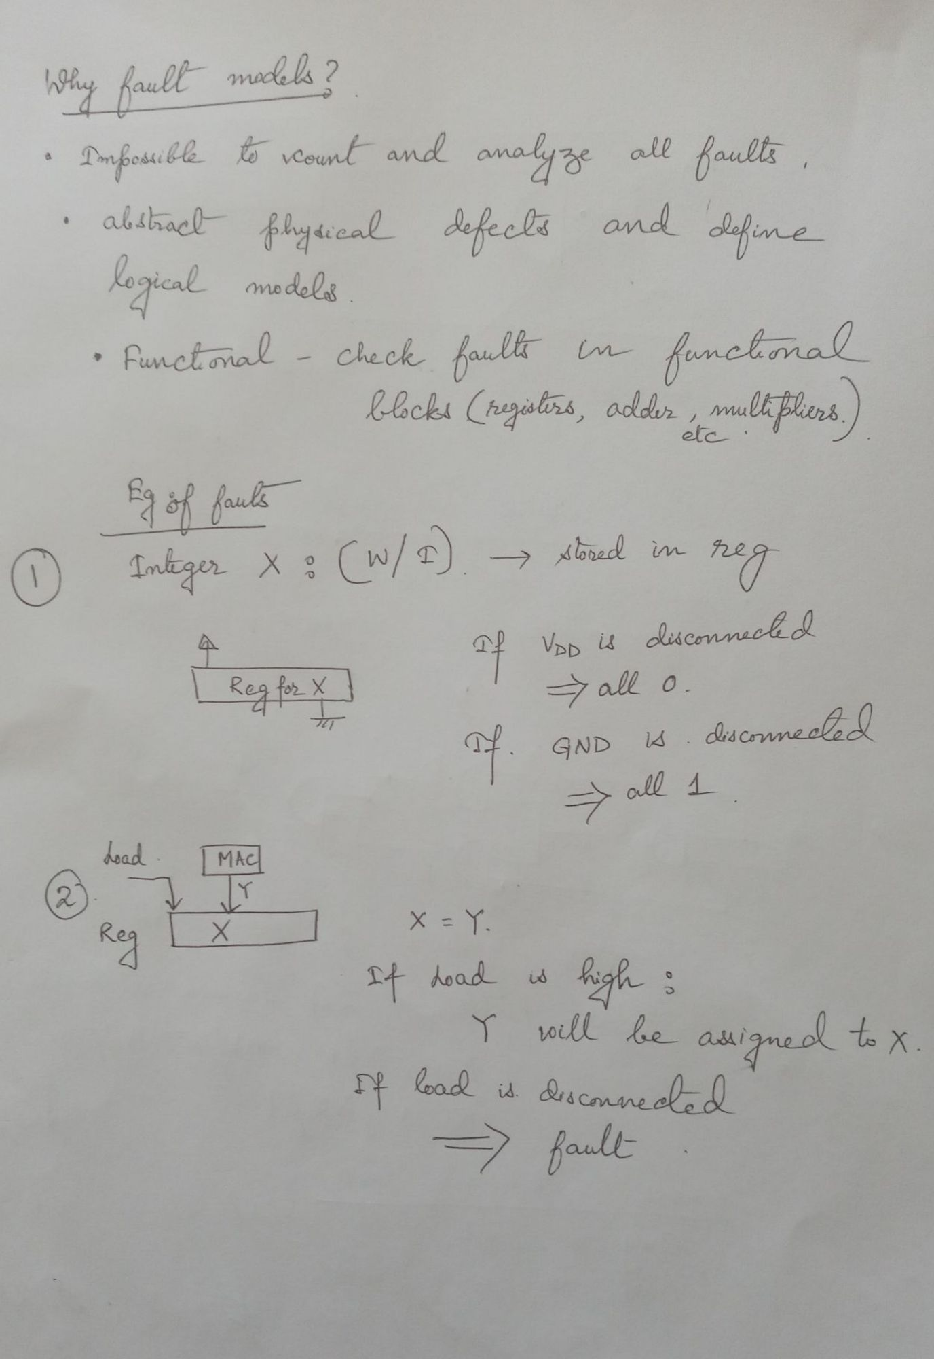
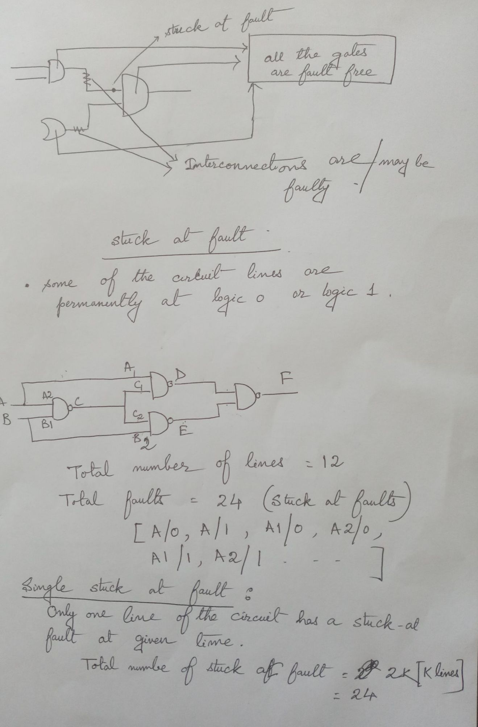

Slide 11
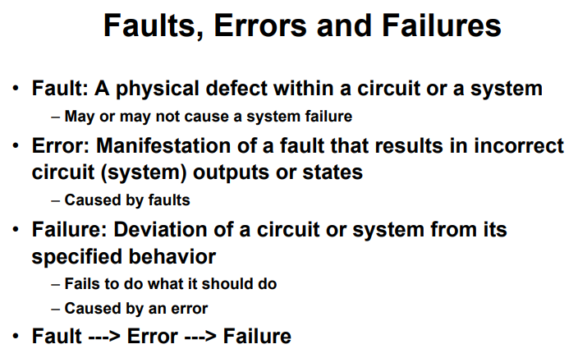

Slide 12
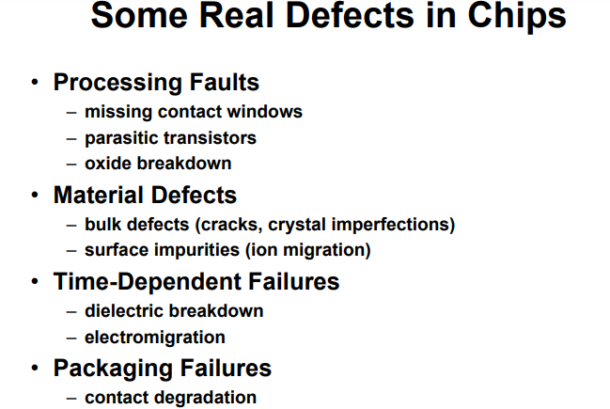
Imperfections in DNN accelerators
DNN accelerators are fabricated using nanometre CMOS technologies, which require a highly sophisticated manufacturing process.
The imperfections in the process result in defects in the fabricated chips.
These defects can take a wide variety of forms, from permanent faults (e.g. stuck-at faults) that affect the functionality of the chips to variations that affect just the operating characteristics of the hardware (e.g. timing errors ).

Slide 13
Permanent faults (e.g. stuck-at faults) in DNN accelerators

Slide 14
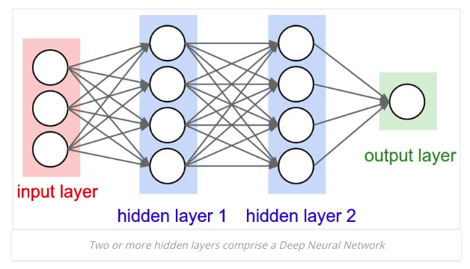
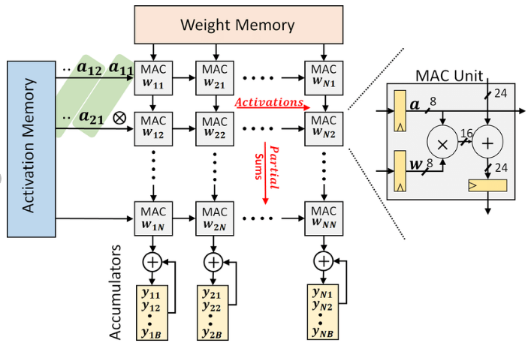
How TPU Works?

Slide 15
How TPU Works?
MAC_11 computes w_11*a_11 in the first clock cycle,
MAC_12 unit adds w_12*a_21 to MAC11’s product in the next clock cycle, and so on.
In clock cycle N, MAC_1N unit outputs:
y_11 = ∑ w_1i*a_i1,
[the first element of the output matrix]
MAC_1N proceeds to output y_12, . . . ,y_1B in subsequent clock cycles.
The second column receives the same stream of inputs as the first column, but delayed by one clock cycle.
This column outputs y_21,y_22, . . . ,y_2B.
In this manner, a batch of B inputs is multiplied by an N × N weight matrix in 2N + B clock cycles.

Slide 16
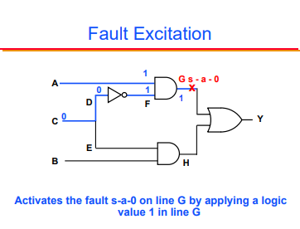
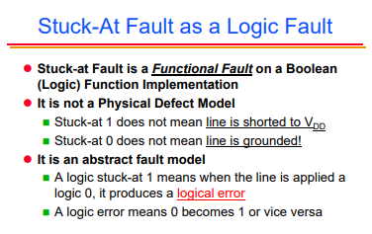
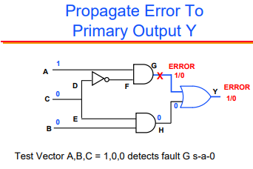
Ref: https://web.stanford.edu/class/ee386/public/stuck_at_fault_6per_page

Slide 17
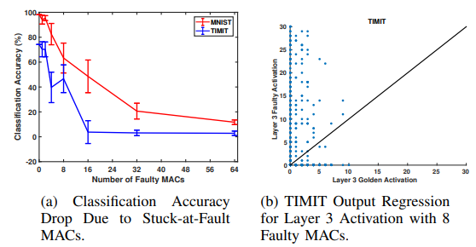
Impact of Permanent Faults on TPU
For TIMIT, we observe that even with only four faulty MACs (i.e., with only ⇠ 0.005% MACs faulty), the classification accuracy drops from the 74.13% to 39.69%.
Golden = Fault free
stuck-at faults frequently affect the higher order bits of the MAC output, resulting in large absolute errors in the matrix vector product.

Slide 18
Solution: Fault-Tolerant TPU Design

Slide 19
Motivation
TPUs with even a relatively small number of faulty MAC units cannot be used unless the fault impact is mitigated.
Observation:
Each weight in the DNN maps to exactly one MAC unit.
In other words, there is a static mapping between DNN weights and MAC units. We then exploit the static mapping to determine which weights to prune.

Slide 20
Mapping in Submatrices
mapping functions r() and c() that take as input the indices of a DNN weight and output the row and column, respectively, of the MAC unit on which the weight is mapped.
The mapping functions for weight wi,j in a fully-connected layer:
r(i, j) = j%N and c(i, j) = i%N, % is the modulo operator.
weight matrices that do not fit fully in the systolic array are first blocked into smaller N ⇥ N sub-matrices

Slide 21
Two Solutions
fault-aware pruning (FAP)
fault-aware pruning plus retraining (FAP+T)

Slide 22
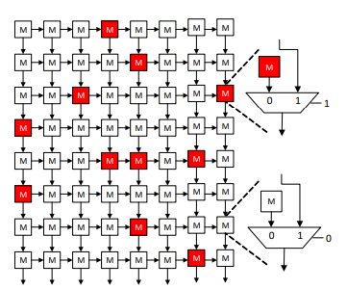
FAP
The proposed FAP and FAP+T techniques both assume that standard post-fabrication tests are used on each TPU chip to determine the location of faulty MACs.
Given this information, FAP is to set (or prune) any weight that maps to a faulty MAC to zero.
That is, for all pairs of (i, j) values such that MACc(i,j),r(i,j) is faulty, we set the corresponding wi,j = 0
this is for fully connected layers, a similar strategy is used for conv layers.
multiple weights can map to one MAC unit; correspondingly, even a single faulty MAC can result in multiple weights being pruned

Slide 23
Pruning in hardware
In hardware, pruning is achieved by introducing a separate bypass path for faulty MAC units.
With the bypass path being enabled, the faulty MAC unit’s contribution to the column sum is skipped, which is equivalent to setting the faulty MAC’s weight to zero.
The area overhead due to the new bypass path is only about 9%.

Slide 24
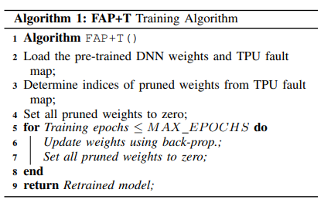
FAP + T
The FAP+T approach starts with FAP based on each TPU’s fault map, but additionally retrains the unpruned weights in the DNN while forcing all pruned weights to zero during the re-training process.
returns new, optimized values for the unpruned weights that improve the classification accuracy compared to the FAP solution.

Slide 25
Limitation
re-training needs to be performed for each TPU chip based on its unique fault map;
however, this needs to be done only once per TPU chip and the cost of doing so is amortized over the entire lifetime of the TPU chip.

Slide 26
MAX EPOCHS : determines the number of iterations of the re-training algorithm.
Setting this parameter to zero is equivalent to FAP.
As MAX EPOCHS is increased, the re-training time increases in return for increased classification accuracy

Slide 27
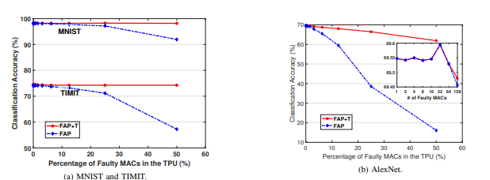
Result
TPUs operate even with fault rates as high as 50%, with negligible to tolerable drops in classification accuracy (from 0.1% drop for TIMIT to 8% drop for AlexNet).

Slide 28
Result
retraining overhead of about 12 minutes per TPU chip for AlexNet. However, this one-time cost is amortized over the entire TPU’s lifetime

Slide 29
Other relevant faults in NN
[Ref: Dependable Deep Learning: Towards Cost-Efficient Resilience of Deep Neural Network Accelerators against Soft Errors and Permanent Faults(https://ieeexplore.ieee.org/stamp/stamp.jsp?tp=&arnumber=9159734)]

Slide 30
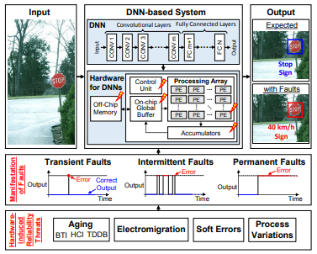
Types of faults
A transient fault is a fault that is not long and can be restored.
An intermittent fault, often called simply an "intermittent", is a malfunction of a device or system that occurs at intervals, usually irregular.
Permanent faults are failures that manifest as stuck-at bits in the architecture, that is, lines that always carry the logical signal “0” or “1” as the result of a short or open circuit.

Slide 31
Soft Errors
Soft Errors are transient faults that manifest as bit flips and result in data corruption. These are mainly caused by extrinsic sources like alpha particles emitted from the impurities in packaging materials or by neutrons from cosmic radiations when they strike the chip.
Temperature is another factor that can result in an increase in the Soft Error Rate (SER).

Slide 32
Aging
Aging of electronic circuits occurs due to various physical phenomena such as Bias Temperature Instability (BTI), Hot Carrier Injection (HCI), Time-Dependent Dielectric Breakdown (TDDB) and Electromigration (EM).
It typically results in circuits becoming slower with time, e.g., by increasing the threshold voltage (VTH) of the circuits, or breakdown of dielectric and wires.
The aging faults manifest as timing errors during the early stages, and later can transform into permanent faults. Alongside various other factors, the rate of aging usually increases with temperature.

Slide 33
Process Variations
Process Variations is an issue caused by the variations introduced during the manufacturing process.
This issue arises due to the fact that it is difficult to manufacture transistors with the same properties, such as channel length, oxide thickness and doping levels, at the nano-scale.
results in performance (e.g., in the form of reduced operating frequency) and power efficiency, as well as the yield of the manufacturing process (in case of permanent faults).

Slide 34
COST-EFFECTIVE RESILIENCE

Slide 35
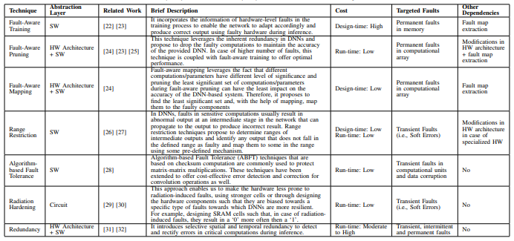

Slide 36
SalvageDNN: salvaging deep neural network accelerators with permanent faults through saliency-driven fault-aware mapping
https://royalsocietypublishing.org/doi/pdf/10.1098/rsta.2019.0164

Slide 37
Limitation of FAP+T
The additional circuitry used for bypassing the MAC units is faulty.
The number of chips manufactured is large and the number of computational units in the DNNaccelerator design is also significant. With an increase in the size of the systolic array, the number of possible fault maps increases significantly. Inthis case, fine-tuning/training a neural network for each faulty chip seems impractical,

Slide 38
Limitation of FAP+T
3. The training dataset is not available, e.g. in a case where a company has released a neural network model, but they have not made the training data available.
4. The above method will lack efficiency in case the number of permanent faults changes over the lifetime of the chip, e.g. due to ageing.

Slide 39
Saliency evaluation of neurons/filters of a DNN
The saliency of a network parameter defines its importance based on its contribution and/or the expected impact it can have on the output.
Widely used methods:
1. L1 and L2 norms, where the norms of the parameters define their saliency:
[ L1 Norm is the sum of the magnitudes of the vectors in a space.
L2 norm:Euclidean norm]

Slide 40

Saliency evaluation of neurons/filters of a DNN
2. Neuron importance score computation based on propagation .
[Such methods are more accurate but computationally more intensive than norm based methods, as they have to back propagate from the output to a particular neuron/filter to compute its saliency.]

Slide 41
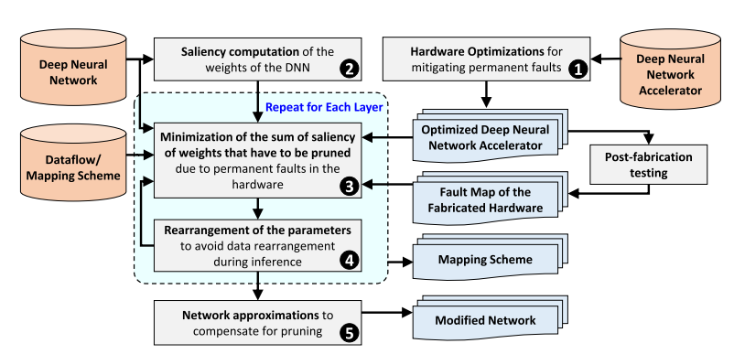
Pruning is a process of removing weights which connect neurons from two adjacent layers in the network.

Slide 42
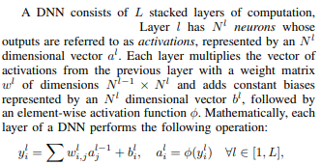
Why Rearrangement?

Slide 43
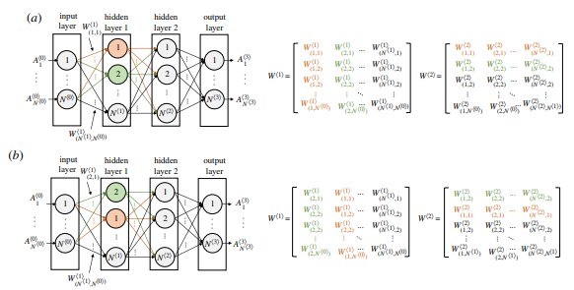

Why Rearrangement?

Slide 44
Why Rearrangement?
Assume that w_ij (a_ij ) is the element in the i-th row and j-th column of weight (activation) matrixW (A).
The operation of the systolic array can be explained
as follows:
First, weights are pre-loaded into the array and remain stationary throughout a block of computation.
MAC unit that stores w_ij as MAC_ij.
Next, activations stream in from the activation
memory, one activation per row per clock cycle, and move from left to right.

Slide 45
Why Rearrangement?
MAC_11 computes w_11*a_11 in the first clock cycle,
MAC_12 unit adds w_12*a_21 to MAC11’s product in the next clock cycle, and so on.
In clock cycle N, MAC_1N unit outputs:
y_11 = ∑ w_1i*a_i1,
[the first element of the output matrix]
MAC_1N proceeds to output y_12, . . . ,y_1B in subsequent clock cycles.
The second column receives the same stream of inputs as the first column, but delayed by one clock cycle.
This column outputs y_21,y_22, . . . ,y_2B.
In this manner, a batch of B inputs is multiplied by an N × N weight matrix in 2N + B clock cycles.
Rearrangement due to change of w_ij locations.

Slide 46
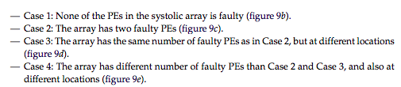
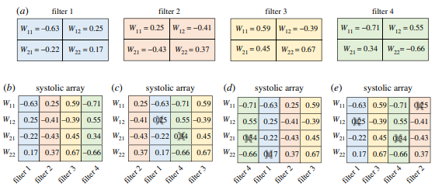

Slide 47
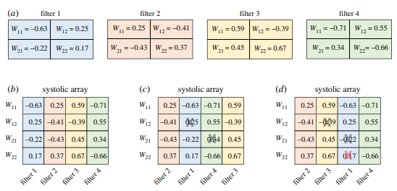
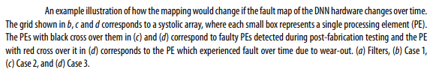

Slide 48
Advantage
Saliency-driven fault-aware mapping, without requiring extensive retraining as typically done in the state of the art.

Slide 49
Steps in the Algorithm
1. The DNN accelerator design is optimized such that the components having permanent faults can be disconnected from the main datapath to mitigate the effects of the faults.
2 Saliency of the weights of the DNN is computed.
3. Given a dataflow, the architectural characteristics of the modified accelerator design and the fault map of the fabricated hardware, mapping of neurons/filters of a layer of the DNN on different segments of the hardware such that the sum of saliency of the weights that are pruned (mapped on the faulty/disconnected parts of the datapath) during inference is minimized.
4. makes the required rearrangements in the DNN such that the data rearrangements, which are highly memory intensive, are not required during the DNN processing.

Slide 50
Steps
Steps 3 and 4 are repeated for each layer and the resultant network is forwarded to step 5 after setting all the weights which are to be mapped on the faulty/disconnected computational units to zero.
The network is traversed in a sequential order from the first layer to the last.
Step 5 , required adjustments are made to the network parameters to compensate for the pruned weights/computations.

Slide 51
Minimization of the sum of saliency

Slide 52
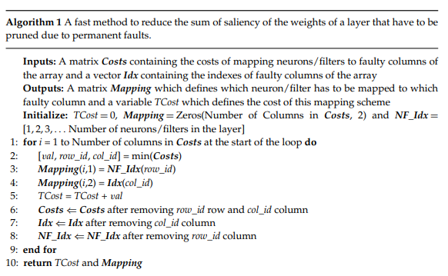

Slide 53
Generation of the Disconnection Map (DM).
The DM is a matrix that defines the MAC units which will be disconnected from the array during processing. This is done by setting the values corresponding to the MACs which will be disconnected in DM to 1.
[For example,if the MAC unit in the first row and first column of the array will be disconnected during processing, the DM(1, 1) is set to 1; otherwise it will be 0.]
The DM is constructed using the fault map of the array. The fault map is represented using two matrices FMMAC and FMMUX, where FMMAC keeps track of the faulty MAC units and FMMUXkeeps track ofthe faulty multiplexers in the array.

Slide 54
Unrolling of the Saliencies of Weights of a Layer in a Matrix S. The matrixS represents the matrix containing the saliency of neurons/filters of a layer in flattened form.
Generation of the Pruning Matrix (PM):
The DM matrix is replicated in x and y dimensions such that the number of columns and rows in the final matrix is at least equivalent to the number of columns and rows in S.
The additional columns (from the right) and rows(from the bottom) are then removed, and the matrix is stored in the Pruning Matrix (PM).
The columns containing all zeros are removed from the PM while keeping track of the original indexes of the non-zero columns in a vector Idx.

Slide 55

Minimization of the Sum of Saliency of the Weights to be Pruned:
The objective of this step is to generate a mapping strategy which minimizes the sum of saliency of weights to be pruned.
It can mathematically be represented as:
Here,S* represents a transformed version of S generated after applying rearrangement of network parameters based on the mapping strategy.

Slide 56
sub-optimal mapping strategy.
Input:
Costsmatrix: the costs of mapping each neuron/filter to each faultycolumn of the systolic array, and
Idxvector: contains the indexes of the faulty columns of the array, as inputs.
TheCost matrix is computed using matrix multiplication of transpose of S with PM.

Slide 58
Revisit The Example

Slide 60
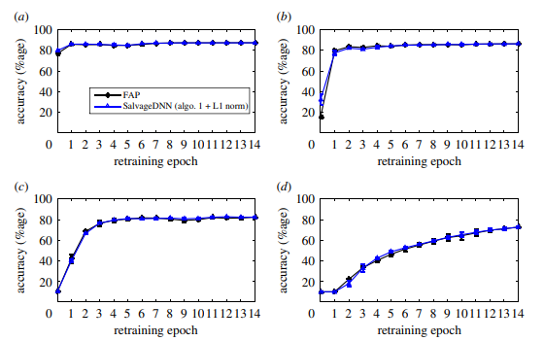

Result

